Slide 1
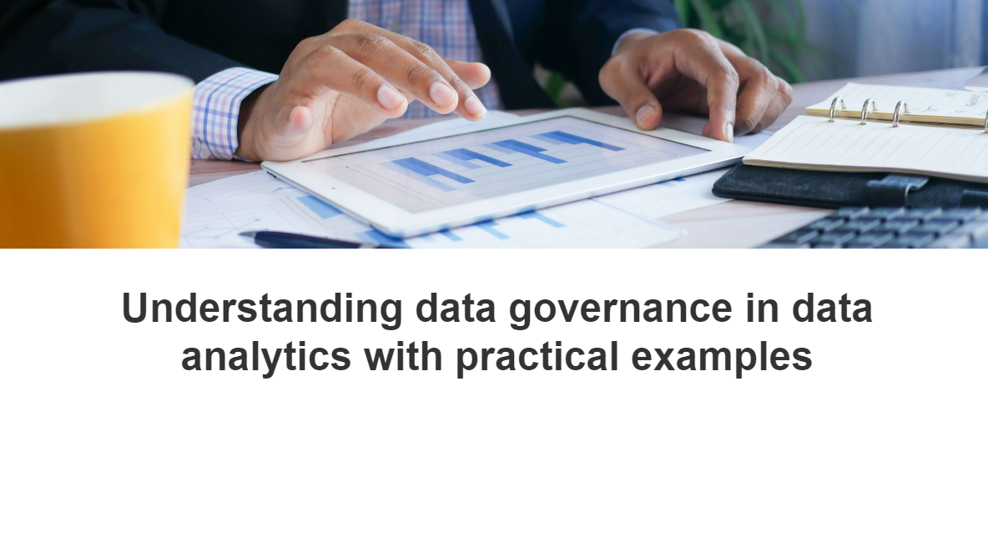

Slide 2
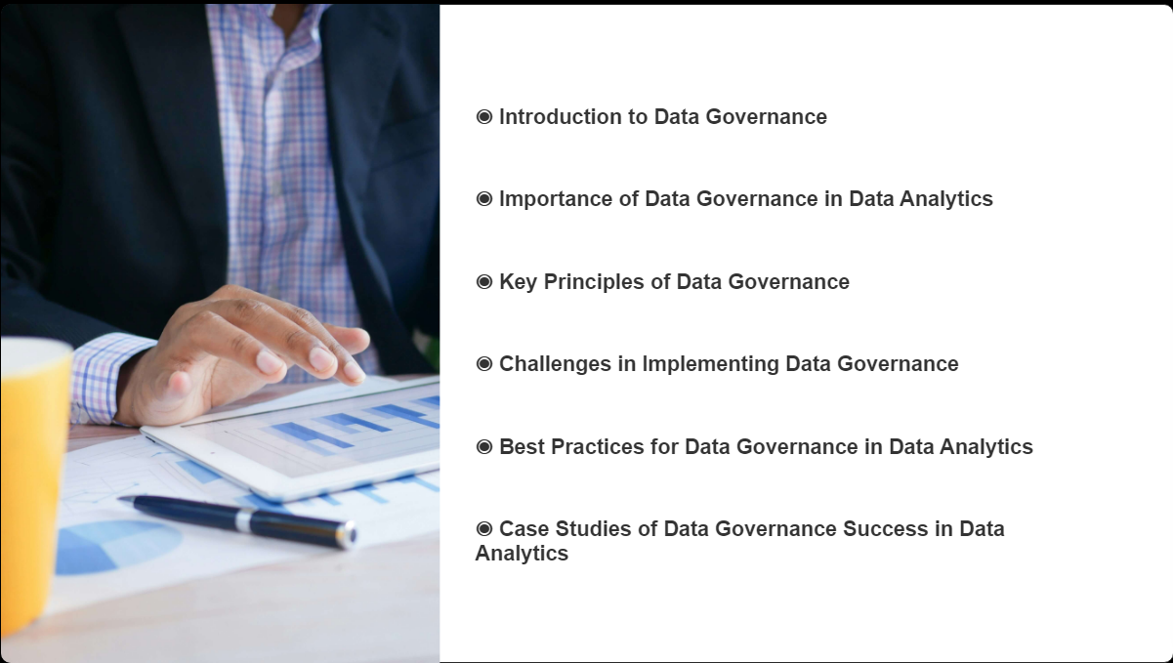

Slide 3
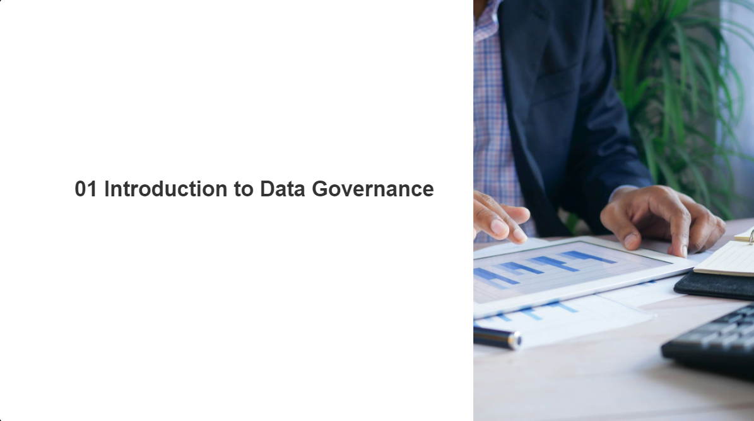

Slide 4
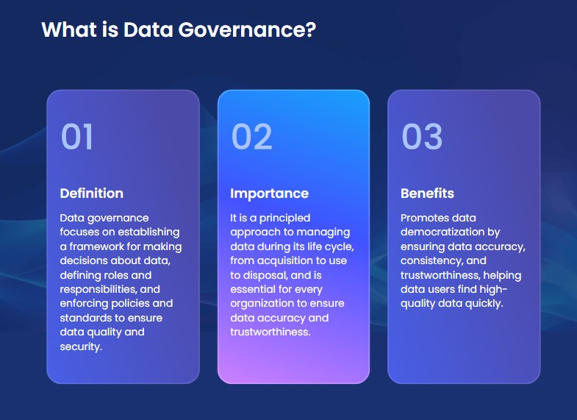

Slide 5
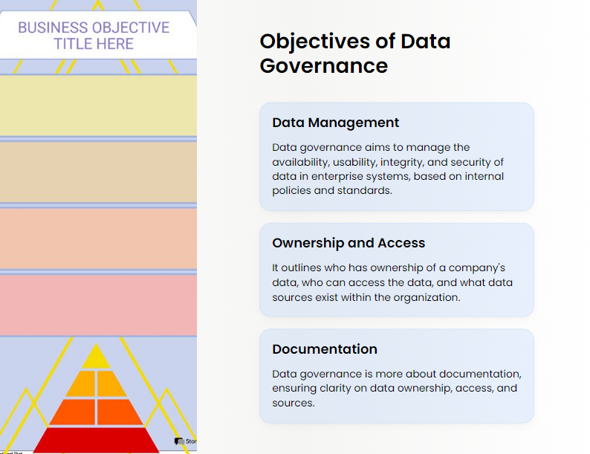

Slide 6
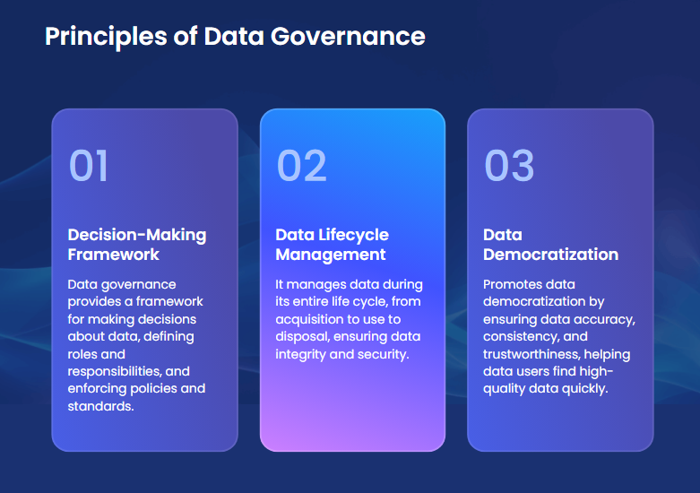

Slide 7
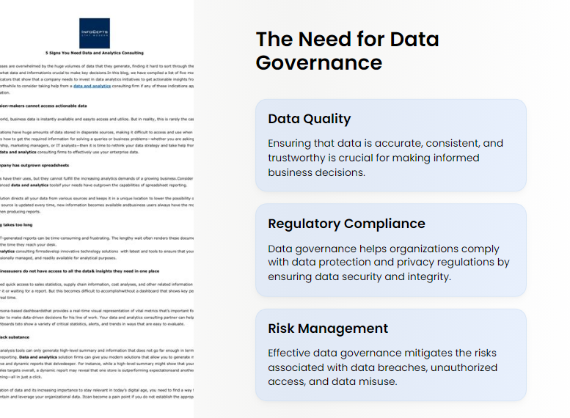

Slide 8
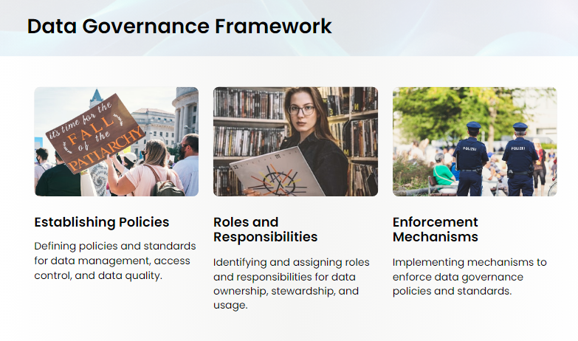

Slide 9
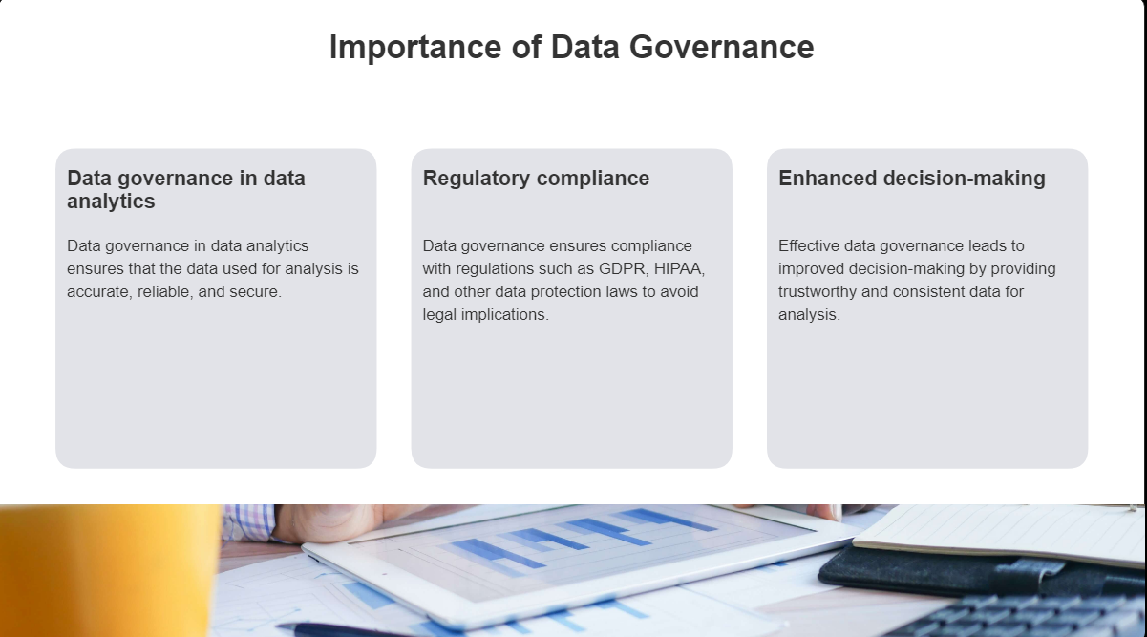

Slide 10
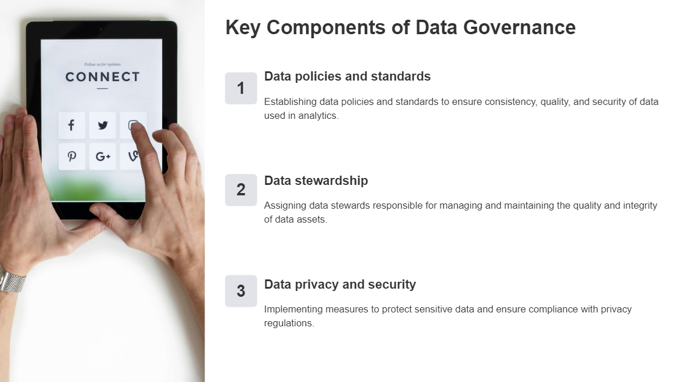

Slide 11
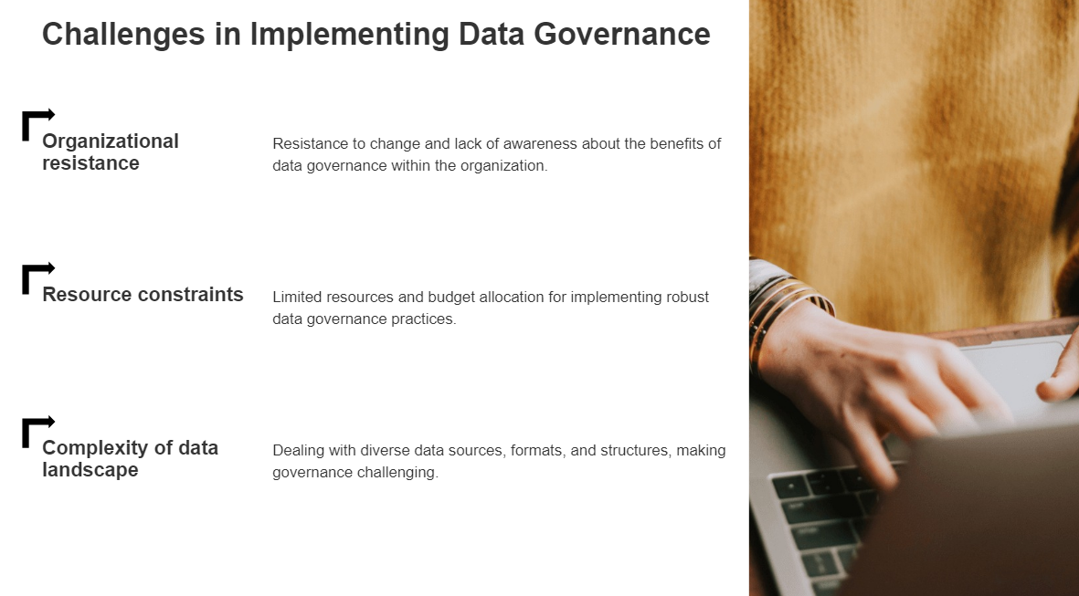

Slide 12
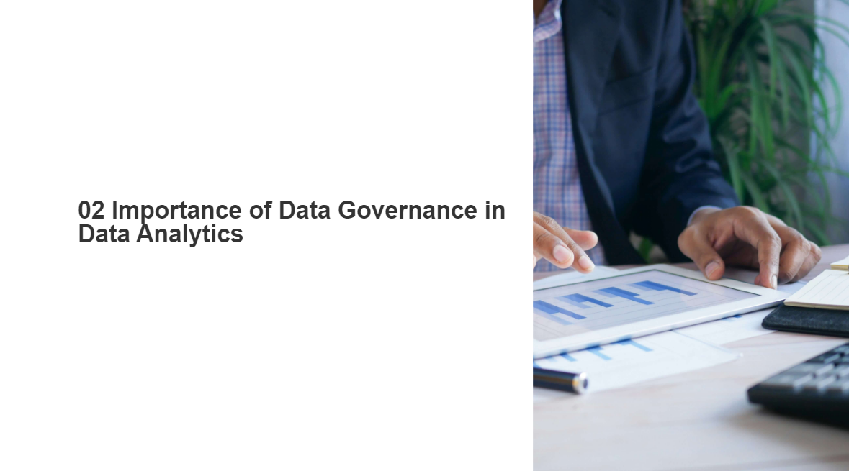

Slide 13
Data governance is a fundamental part of any organization that works with big data and results in consistent, common business processes and responsibilities across the map. It highlights the type of data that needs to be carefully controlled through the organization’s data governance strategy. It sets clear rules relating to the roles of individuals with access or who are responsible for data, and the rules must be agreed upon across different departments of the organization.

Slide 14
For example, maintaining the privacy of patient information and health records is especially important in the healthcare industry. For organizations, such as hospitals or individual doctors’ offices, it is certainly necessary to manage patient data securely as it flows throughout the business.

Slide 15
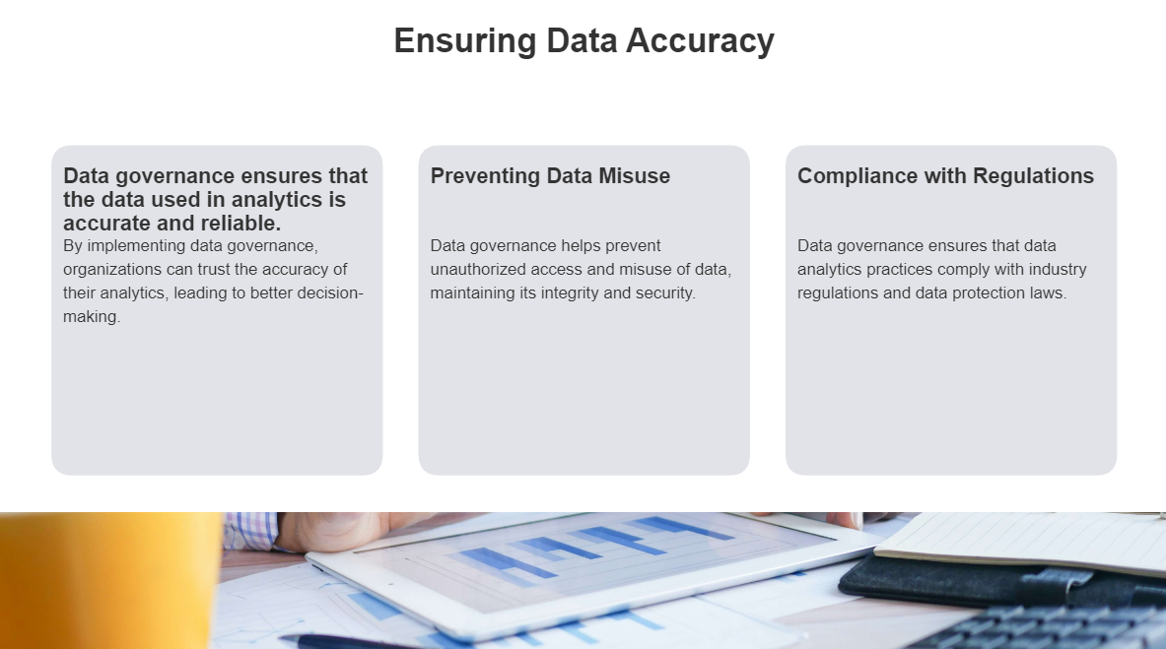

Slide 16
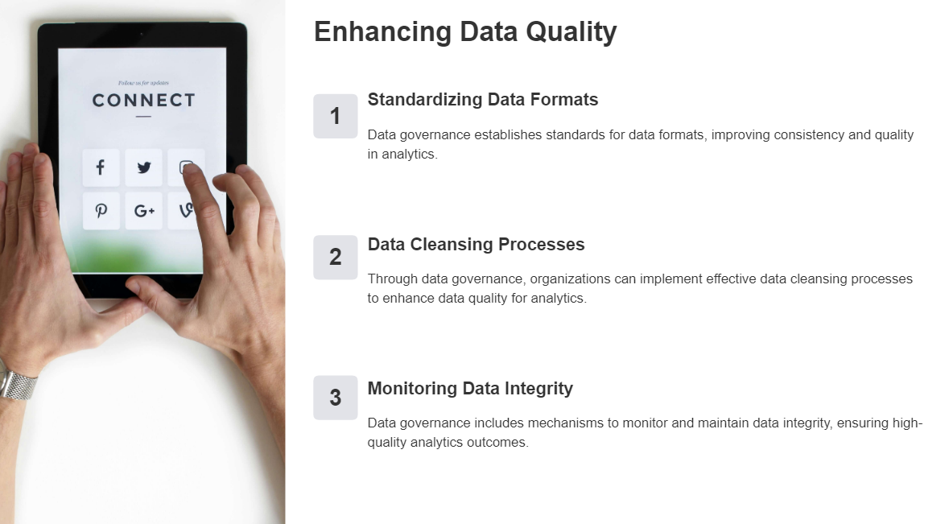

Slide 17
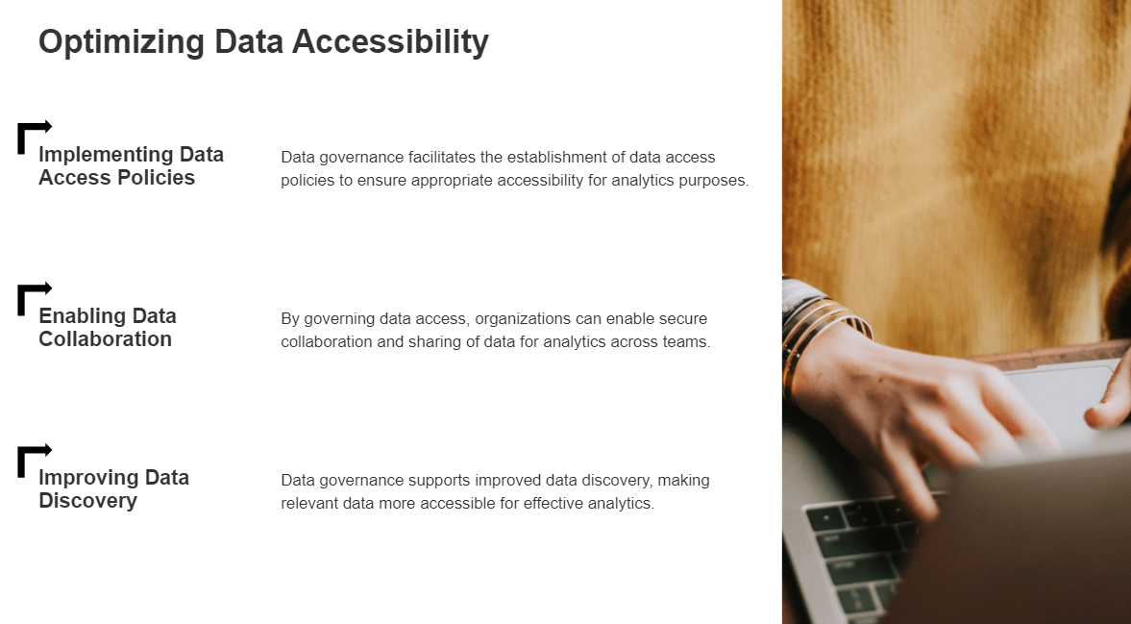

Slide 18
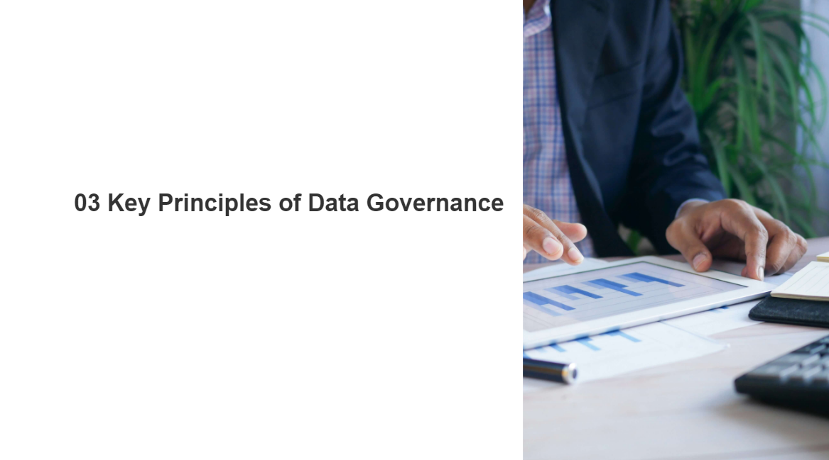

Slide 19
Key Principles
Integrity
Data Governance participants will practice integrity with their dealings with each other; they will be truthful and forthcoming when discussing drivers, constraints, options, and impacts for data-related decisions.

Slide 20
Key Principles
Transparency
Data Governance and Stewardship processes will exhibit transparency; it should be clear to all participants and auditors how and when data-related decisions and controls were introduced into the processes.

Slide 21
Key Principles
Auditability
Data-related decisions, processes, and controls subject to Data Governace will be auditable; they will be accompanied by documentation to support compliance-based and operational auditing requirements.

Slide 22
Key Principles
Accountability
Data Governance will define accountabilities for cross-functional data-related decisions, processes, and controls.
Often, Data Governance can provide a great service by addressing “gaps and overlaps” in data-related accountabilities. Look for situations where either NO ONE is accountable or SO MANY groups are listed as accountable that it’s likely that no one really is.

Slide 23
Key Principles
Stewardship
Data Governance will define accountabilities for stewardship activities that are the responsibilities of individual contributors, as well as accountabilities for groups of Data Stewards.
Don’t overlook situations where someone has not received the formal designation of Data Steward. They may still have stewardship responsibilities that should be baked into their formal accountabilities.

Slide 24
Key Principles
Checks-and-Balances
Data Governance will define accountabilities in a manner that introduces checks-and-balances between business and technology teams as well as between those who create/collect information, those who manage it, those who use it, and those who introduce standards and compliance requirements.

Slide 25
Key Principles
Standardization
Data Governance will introduce and support standardization of enterprise data.
Not everything can be standardized – nor should it be. But achieving data standardization is a prerequisite for many high-value Business and IT projects. And it NEVER is achieved in a sustainable fashion without Data Governance and Stewardship

Slide 26
Key Principles
Change Management
Data Governance will support proactive and reactive Change Management activities for reference data values and the structure/use of master data and metadata.
If you want sustainable success for projects that involve data, then you need to control how that data changes. Yes, some data is supposed to change frequently. Other data – such as a list of valid values for the “State or Province” field in an address – should change rarely, and only with great deliberation and impact analysis. Most Data Governance programs become involved in data-related change management activities, if only by baking change notification activities into Data Stewardship accountabilities.

Slide 27
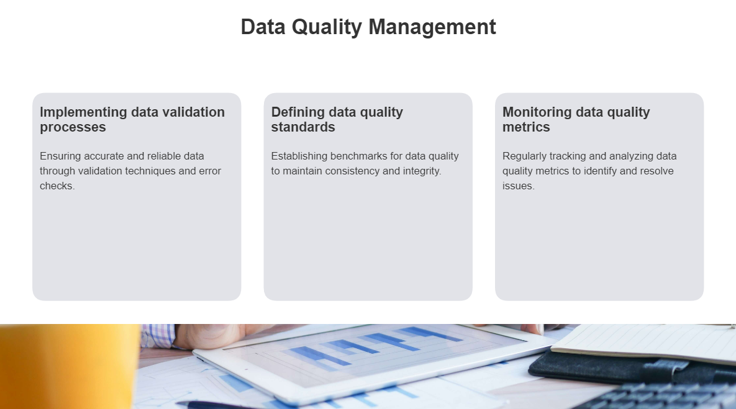

Slide 28
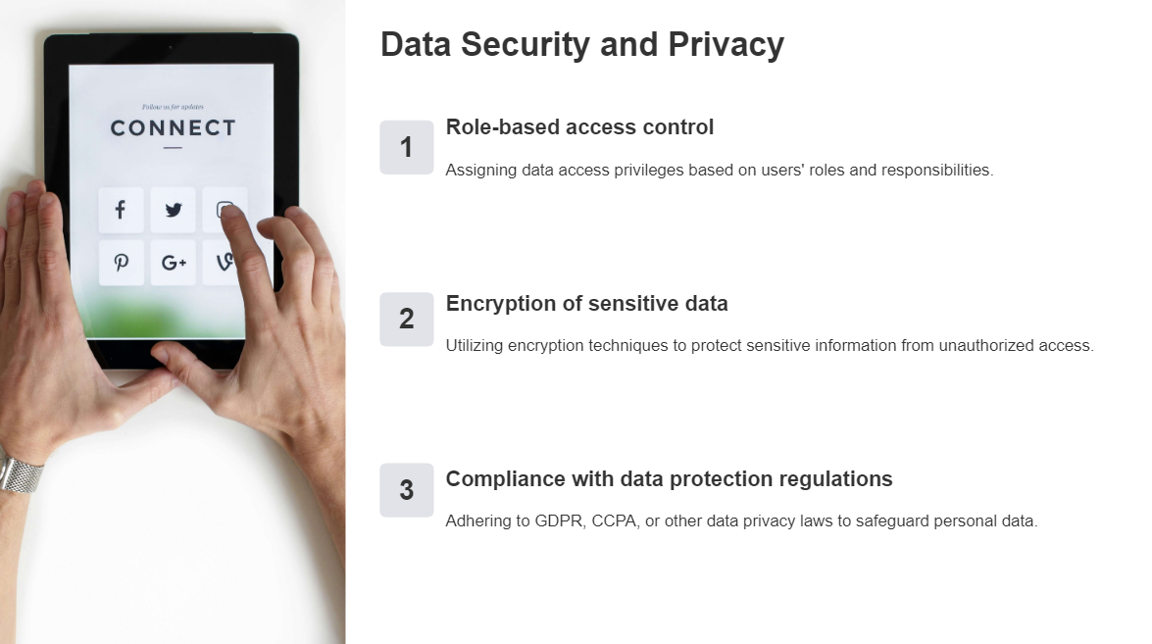

Slide 29
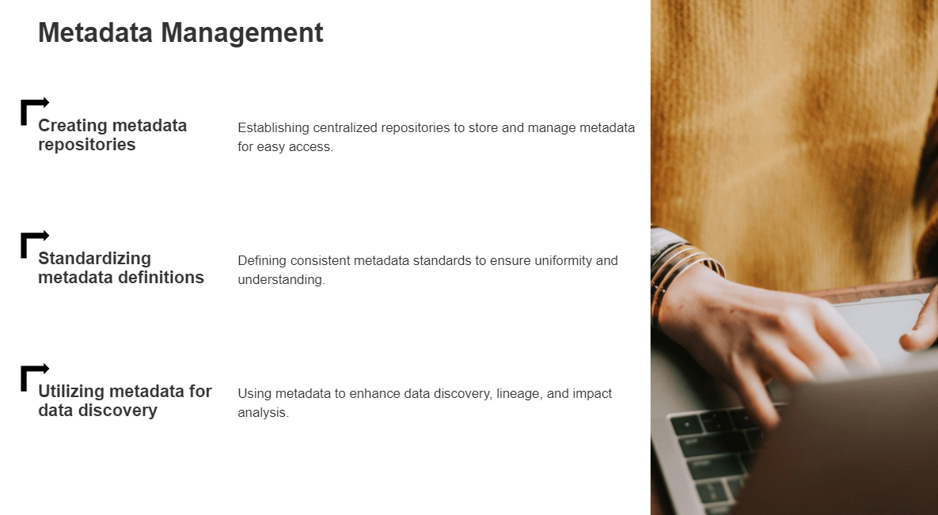

Slide 30
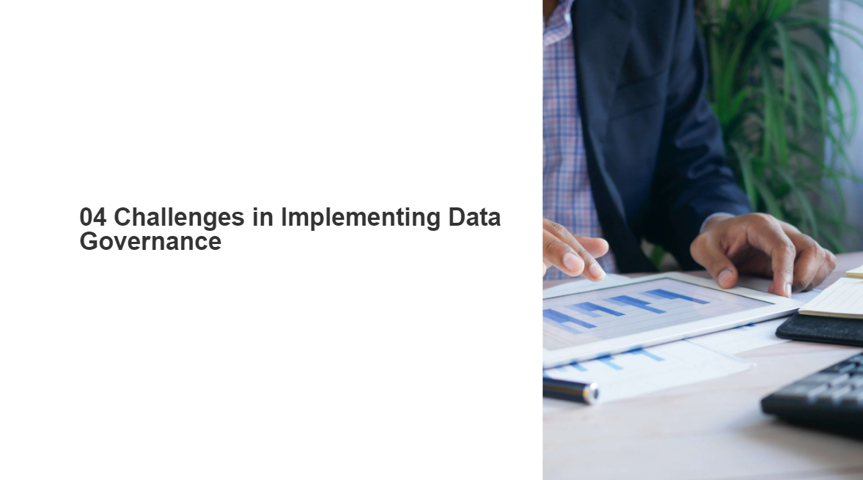

Slide 31
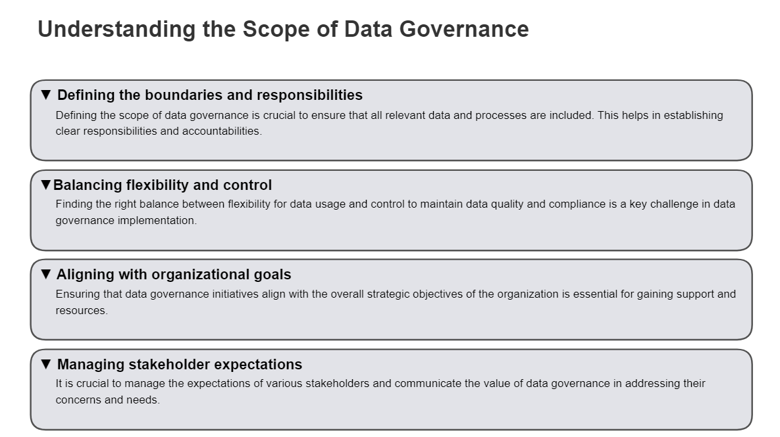

Slide 32
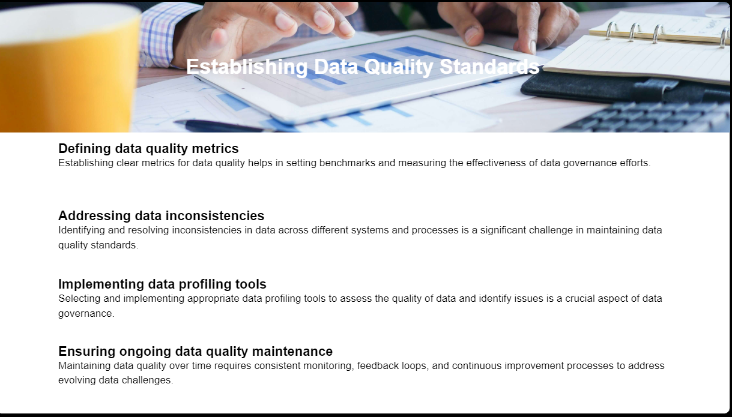

Slide 33
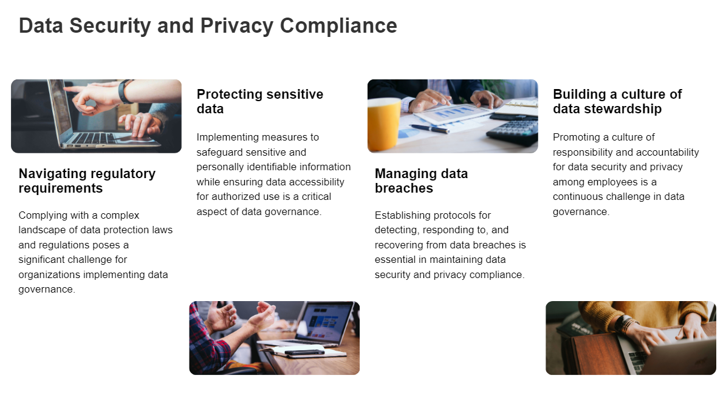

Slide 34
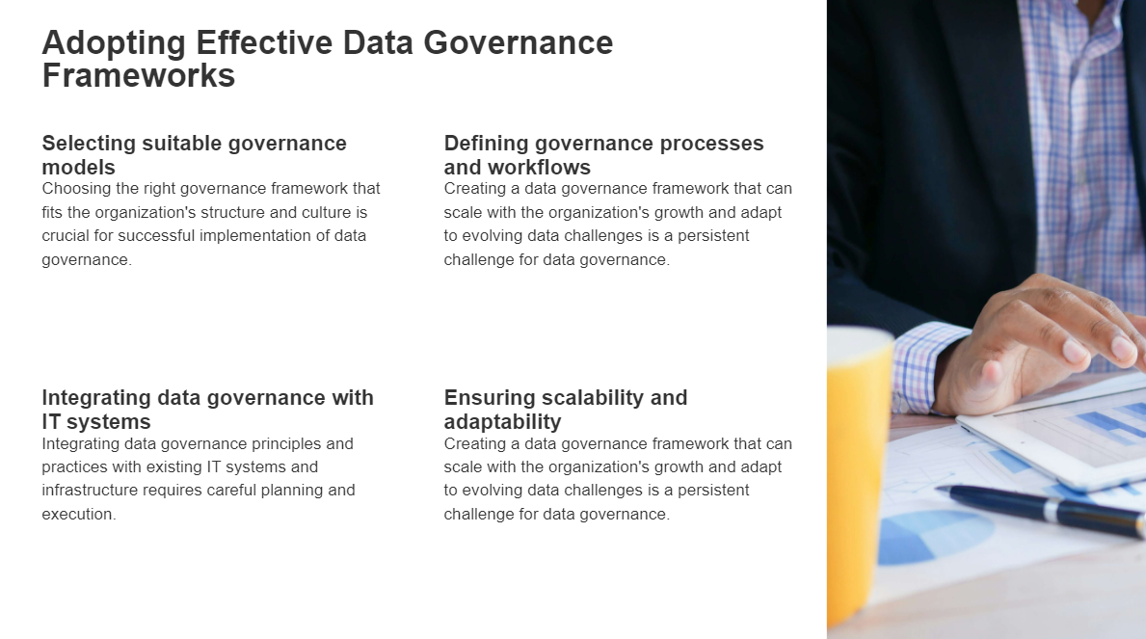

Slide 35
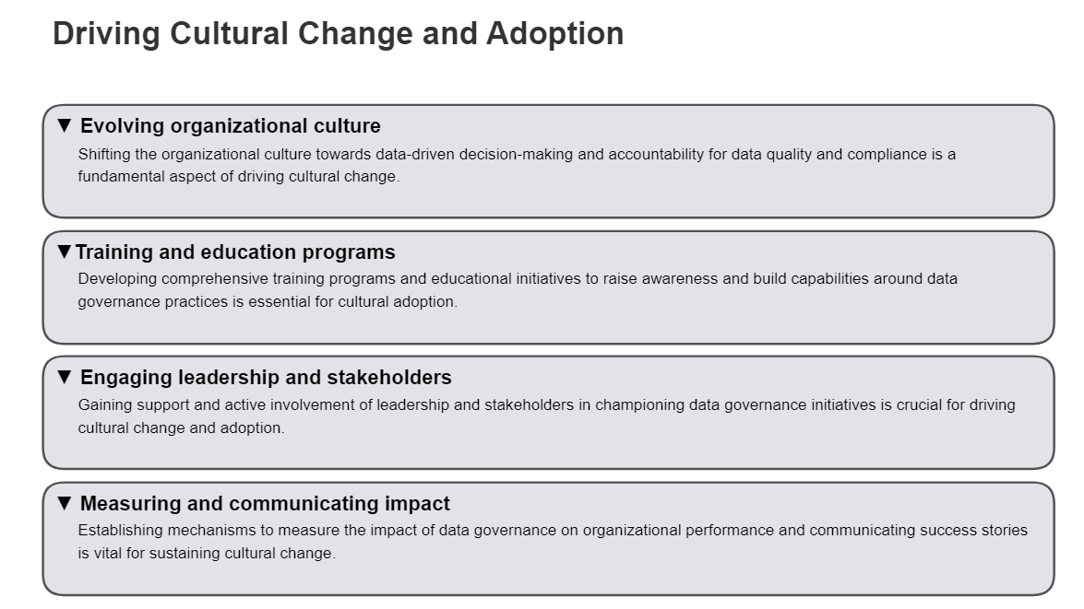

Slide 36
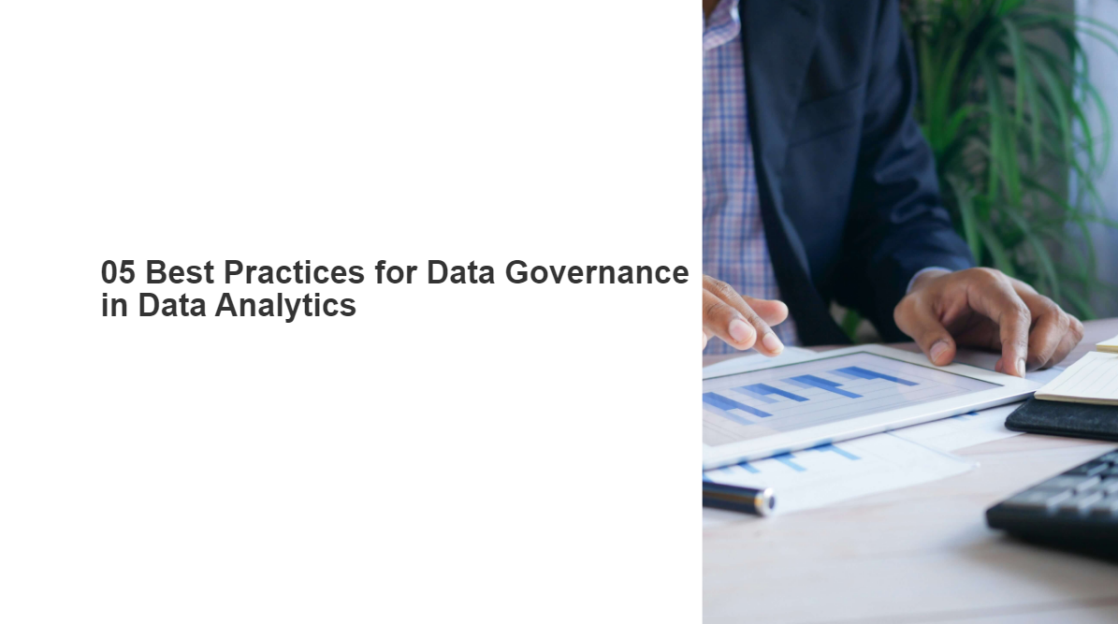

Slide 37
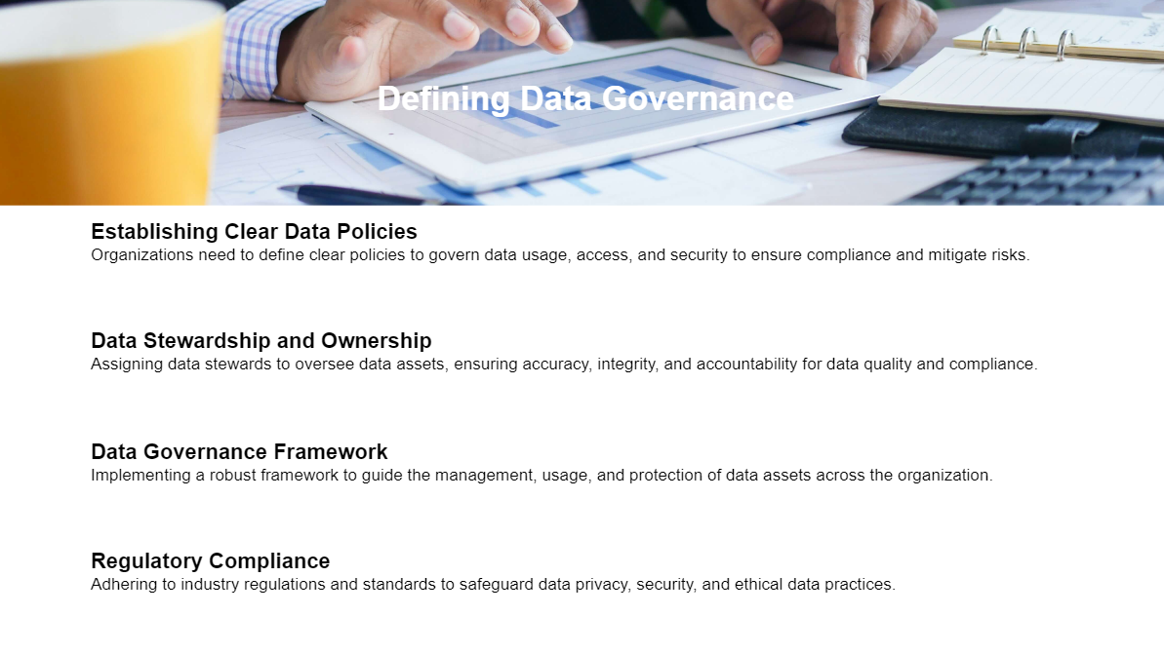

Slide 38
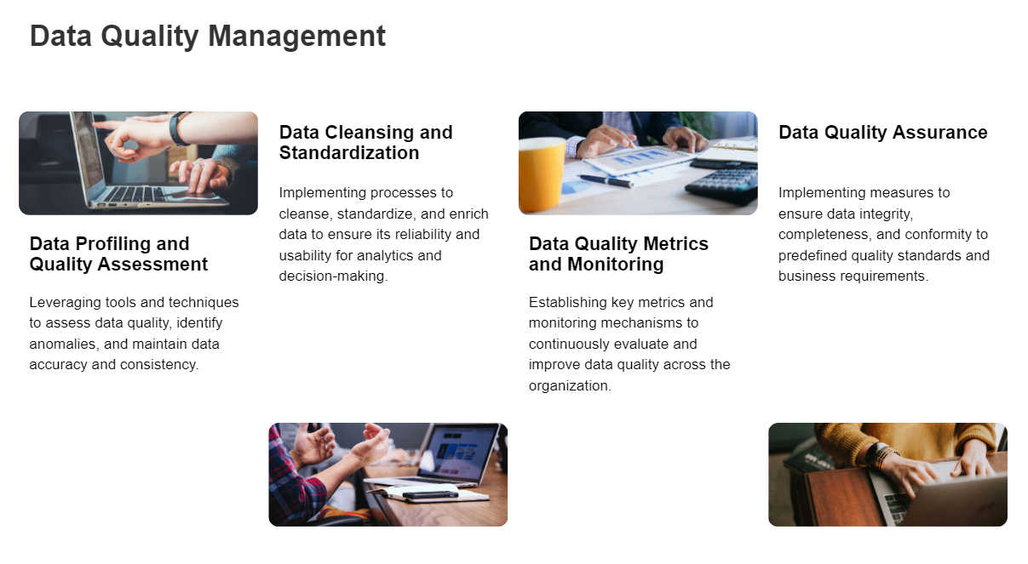

Slide 39
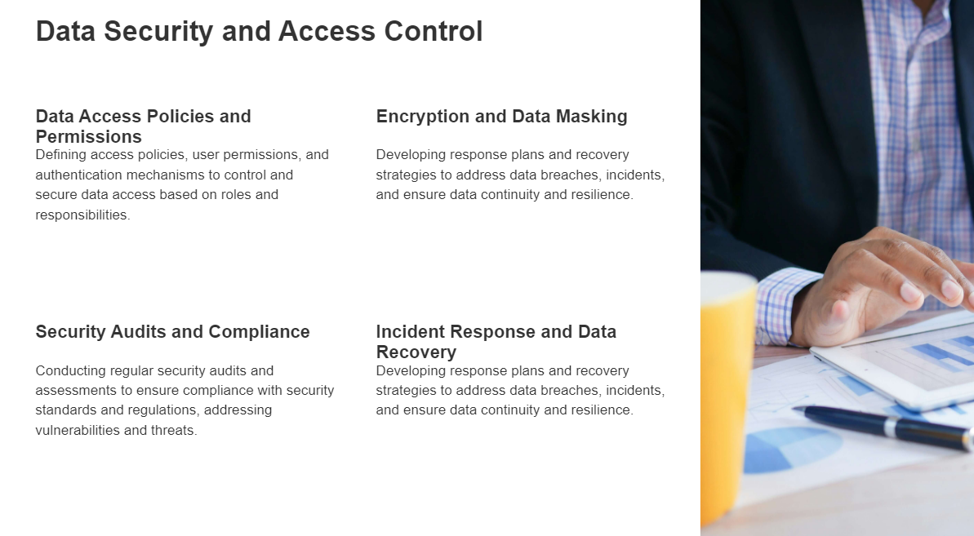

Slide 40
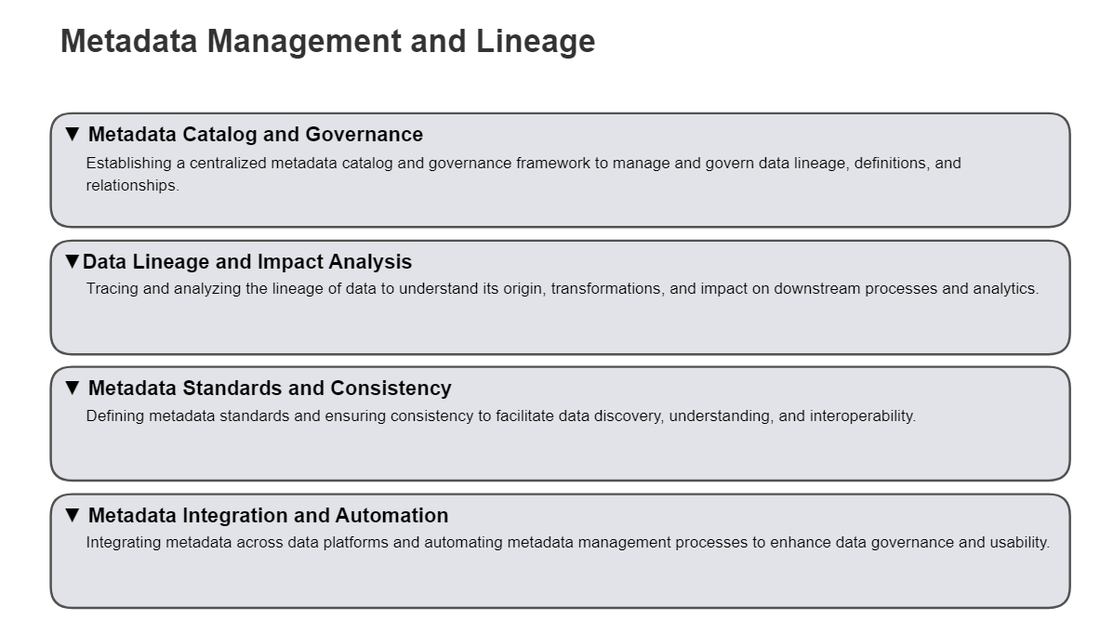

Slide 41
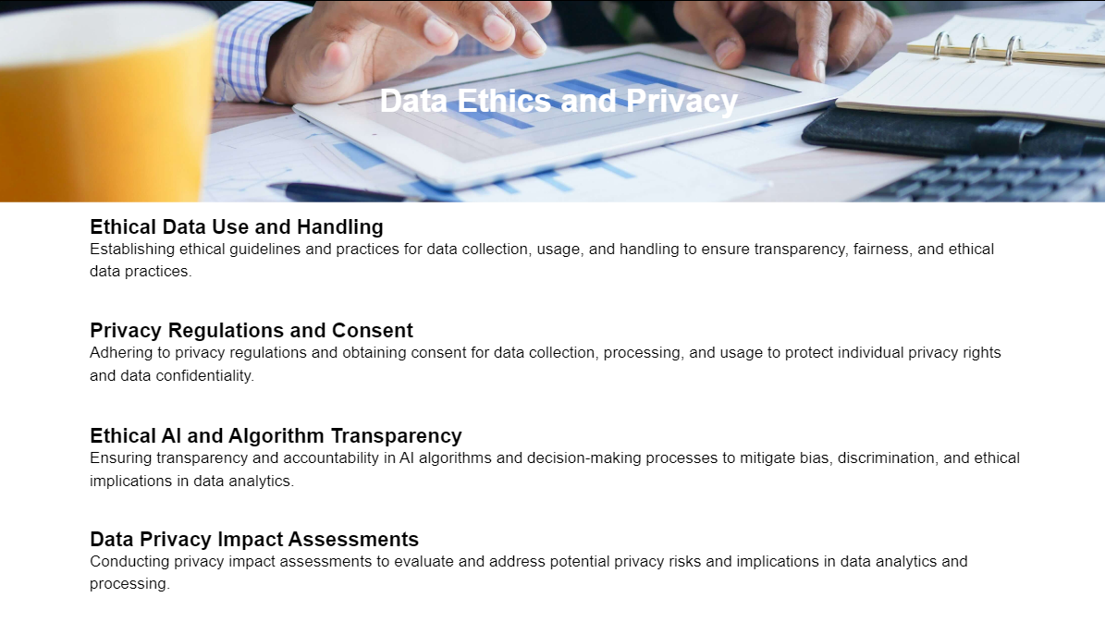

Slide 42
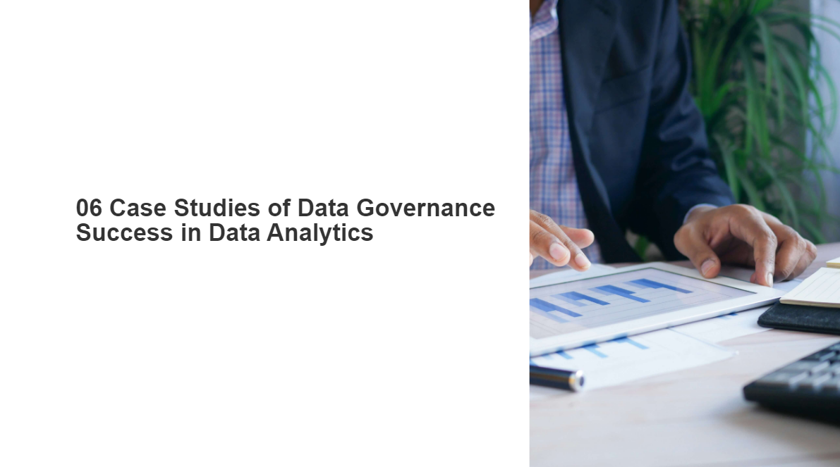

Slide 43
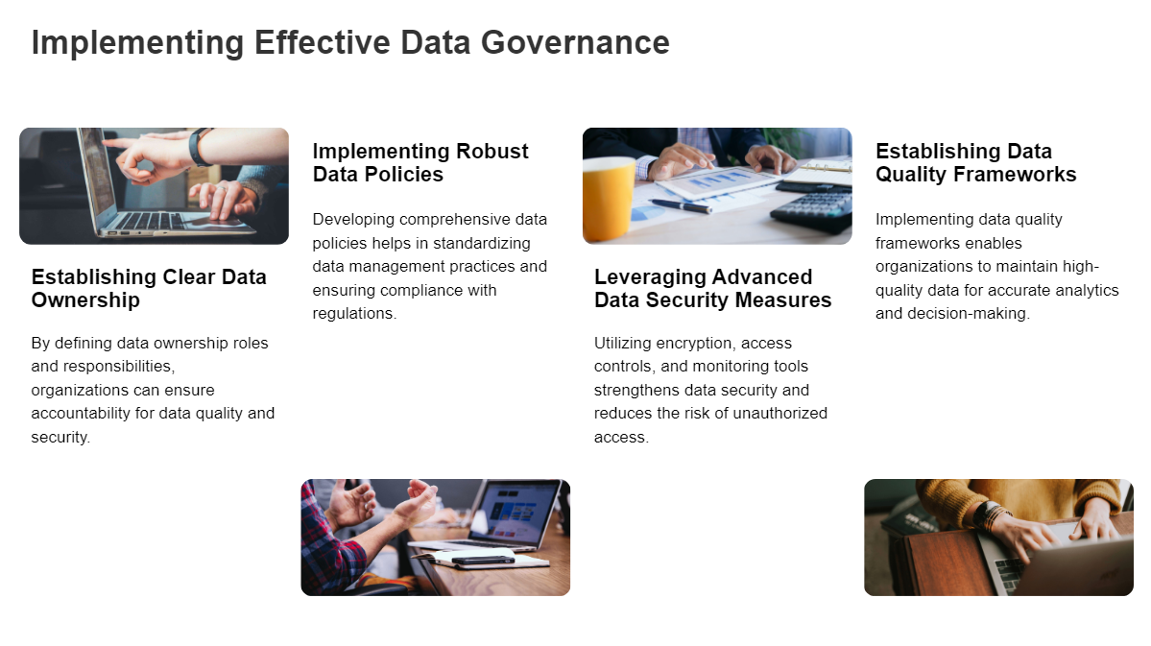

Slide 44
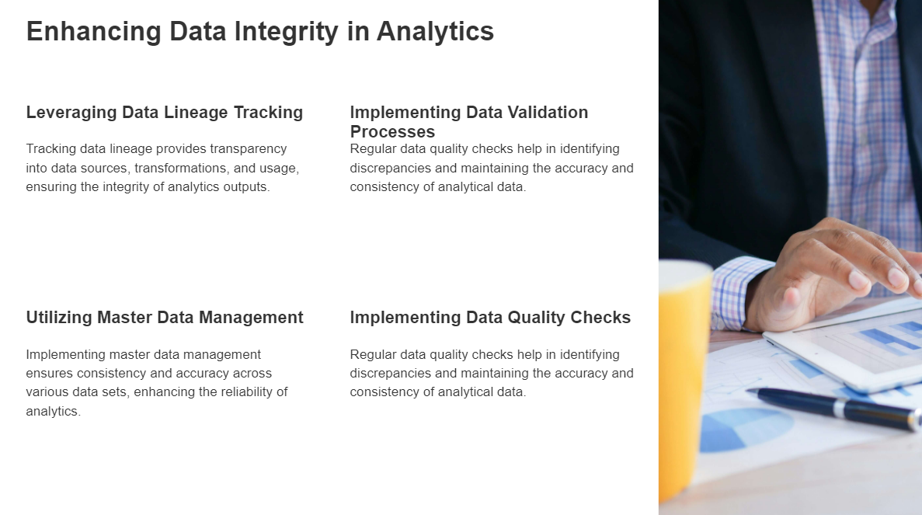

Slide 45
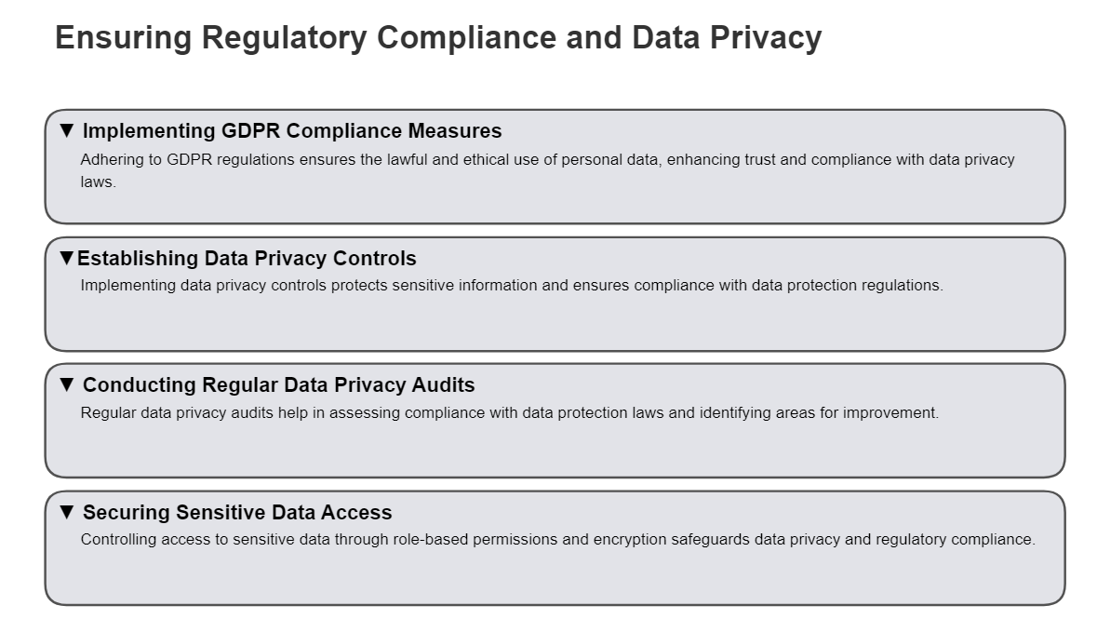

Slide 46
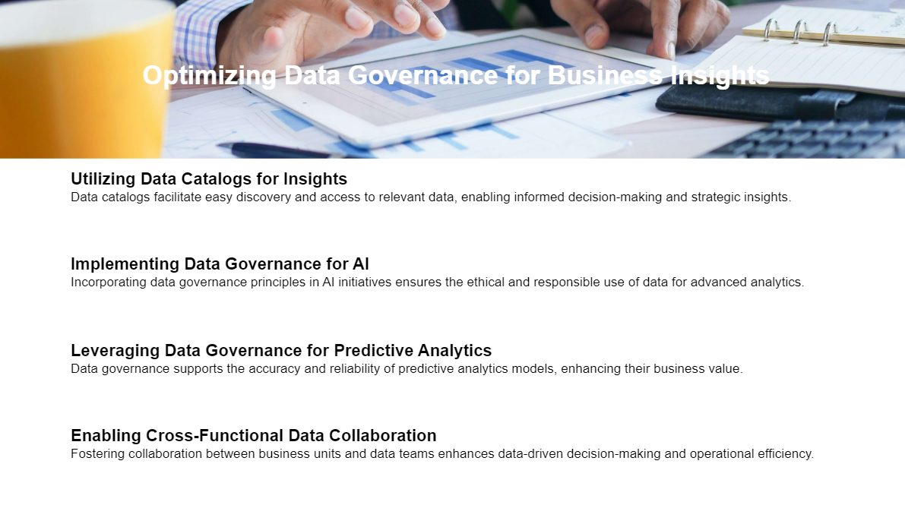

Slide 47
